Slide 1

Karnataka State Akkamahadevi Women’s
University Vijayapur
Topic : Server, web server, E-mail server
and Web Browser
Sub : Computational biology
Presented by : Geeta Nayak

Slide 2
CONTENTS
Definition of Server
History of Server
Types of Server
E-mail Server
Web Server
Application of Server
Web Browser

Slide 3
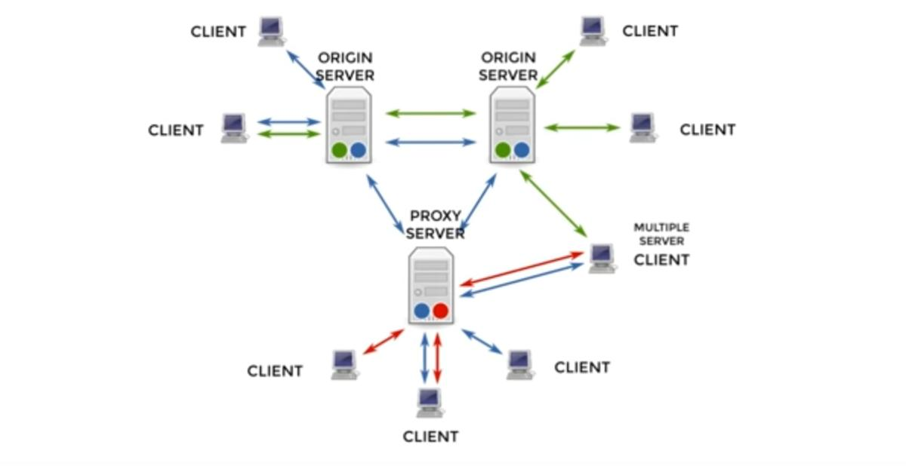
Definition of Server
Server can provide various functionalities often called Services such as sharing data or resources among multiple clients or performing computation for a client

Slide 4
History of Server
Year | Server
1981 | The IBM VM machine, first list Server
1991 | Nextcube, first web server
1994 | Proliant, first Rack Mountable server
1998 | Sun ultra ||, first Google server
2001 | RLX Blade, first modern blade server
2008 | PS3 cluster, distributed computing with GPUS
2009/2012 | The cloud and beyond

Slide 5
Types of Server
Application Server
Client Server
Collaboration Server
FTP Server
List Server
Mail Server
Open Source Server
Proxy Server
Web Server

Slide 6
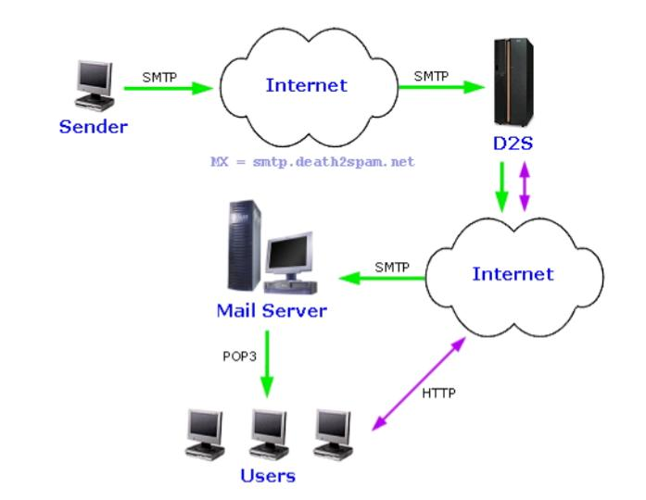
E-mail Server
Mail server is a type of Server which send and receive email using standard protocol
Mail server software is available for multiple platforms
The most popular mail server for windows is Microsoft exchange server

Slide 7
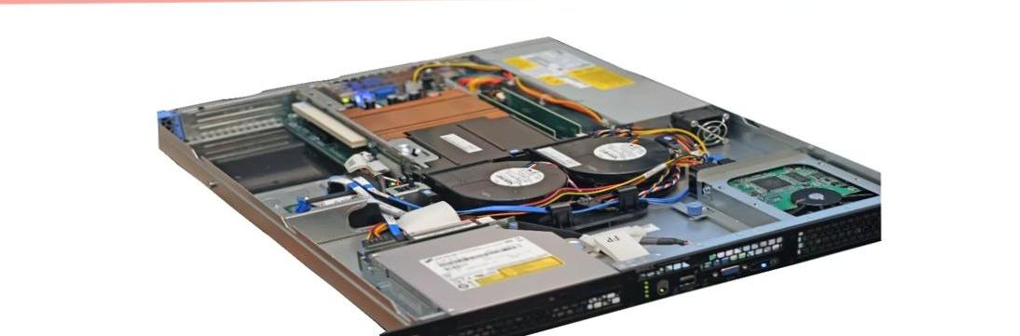
Web Server
Web Server are computer’s that deliver web pages
Every web server has an IP address and possibly a domain name
There are many web server software application, including public domain software and commercial package

Slide 8
Application of Server
It supports multithreading along with other features
It is used to facilitate longer running processes that are more resource intensive

Slide 9
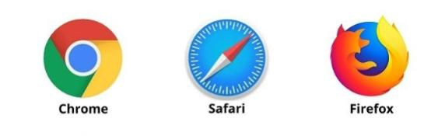
Web Browser
Browser are the most commonly used type of HTTP agent
The browser are used to access the world wide web
They can also be used to access information provided by web server in private network
Example : Google Chrome,

Slide 10
Reference
http://www.shutterstock.com

Slide 11


